Slide 1



Medicare Part D Spending
View in Power BI
Last data refresh:
10/18/2024 12:32:22 AM UTC
Downloaded at:
10/18/2024 1:46:26 AM UTC

Slide 2
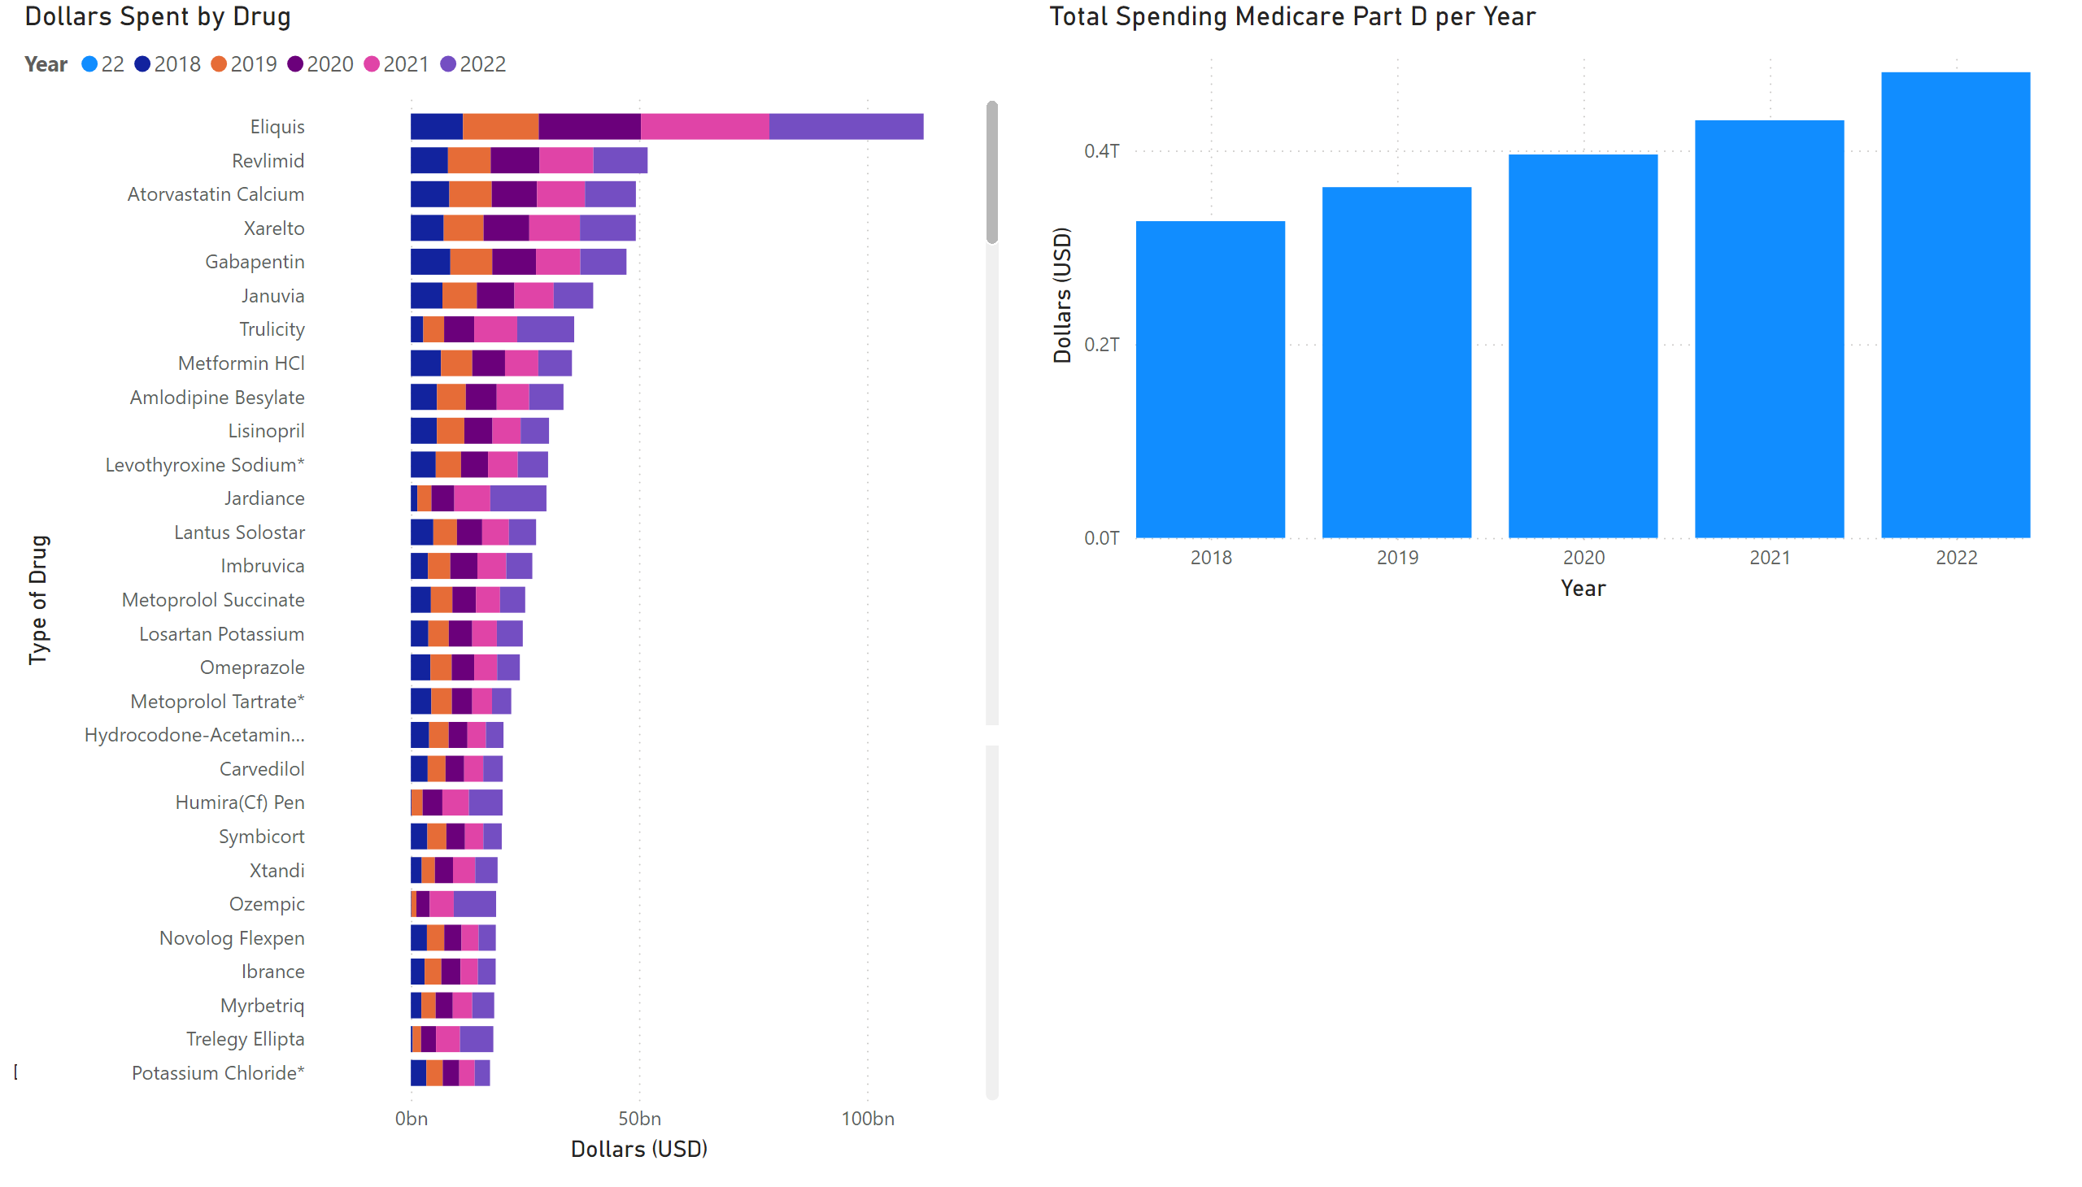
Page 1
Notes:
Dollars Spent by Drug
No alt text provided
Total Spending Medicare Part D per Year
No alt text provided
slicer
No alt text provided
qnaVisual
No alt text provided
qnaVisual
No alt text provided

Slide 3
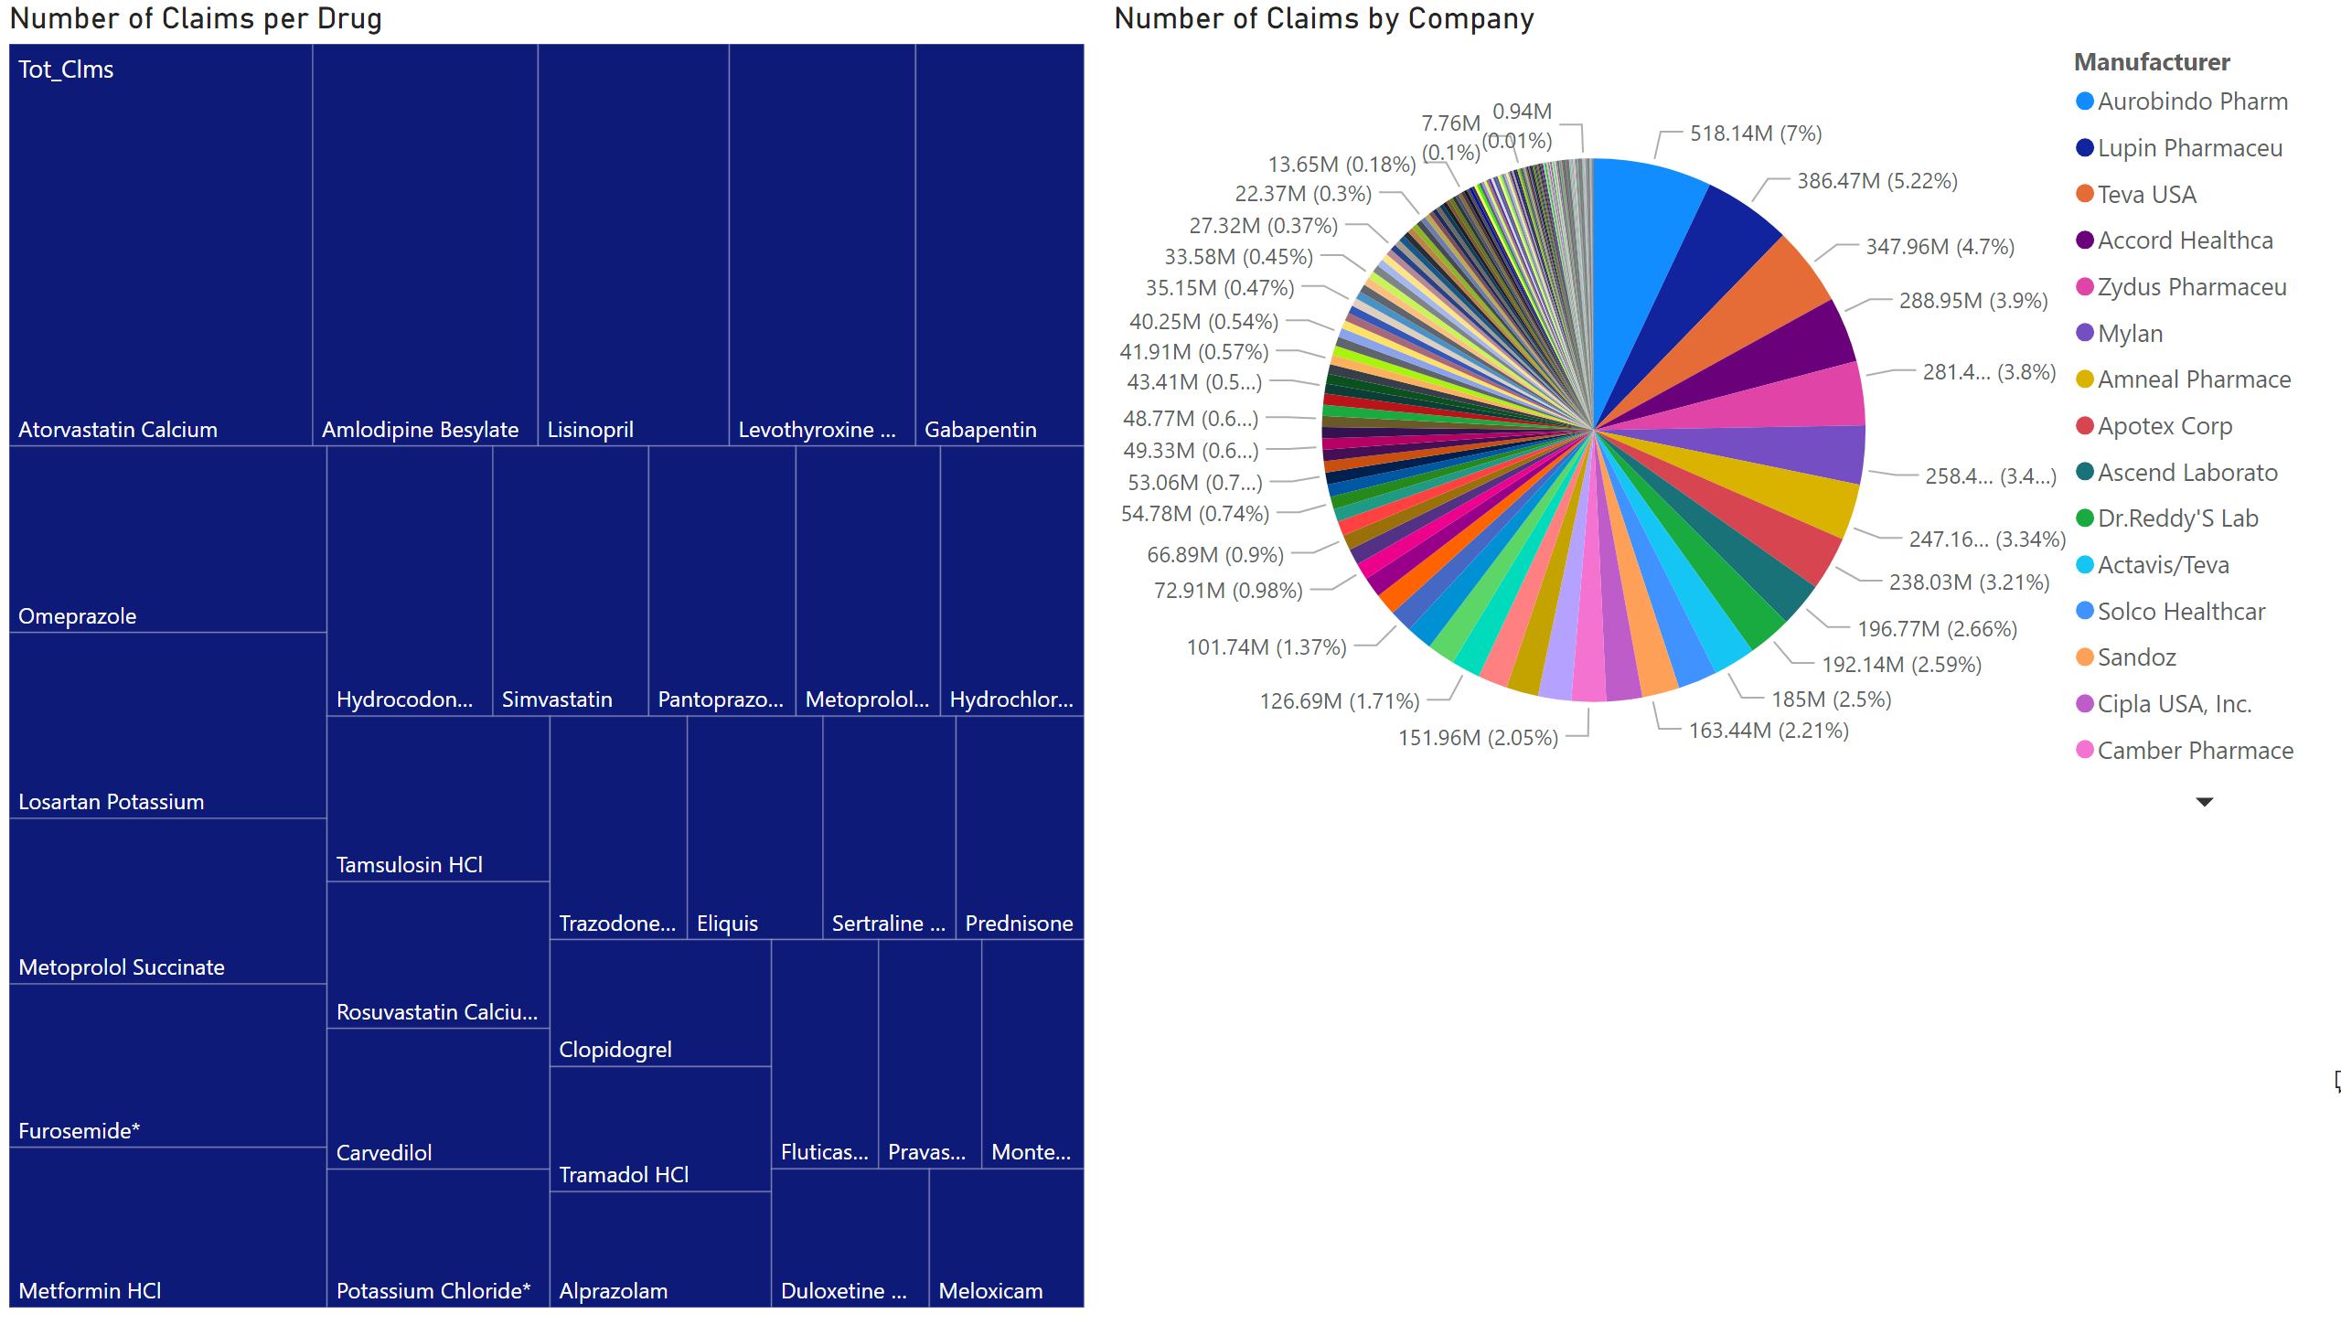
Page 2
Notes:
qnaVisual
No alt text provided
Number of Claims by Company
No alt text provided
Number of Claims per Drug
No alt text provided

